Slide 1

COMMUNITY SERVICE
INTER-CLUB COUNCIL
SPRING RETREAT 2015

Slide 2
INTRODUCTIONS
Name
Major
Club/Organization
Last movie you saw – good or bad?

Slide 3
BREAK-OUT GROUPS
What is the mission/purpose of your club?
How do you accomplish it?
What aspects of your club are service related? Or what makes your club a “service” club?
What aspects are not service related?

Slide 4
WHAT IS COMMUNITY SERVICE ICC?
A council composed of service based student clubs/organizations .
The council helps to facilitate the allocation of ASI money to clubs /organization for programs, events, and travel.

Slide 5
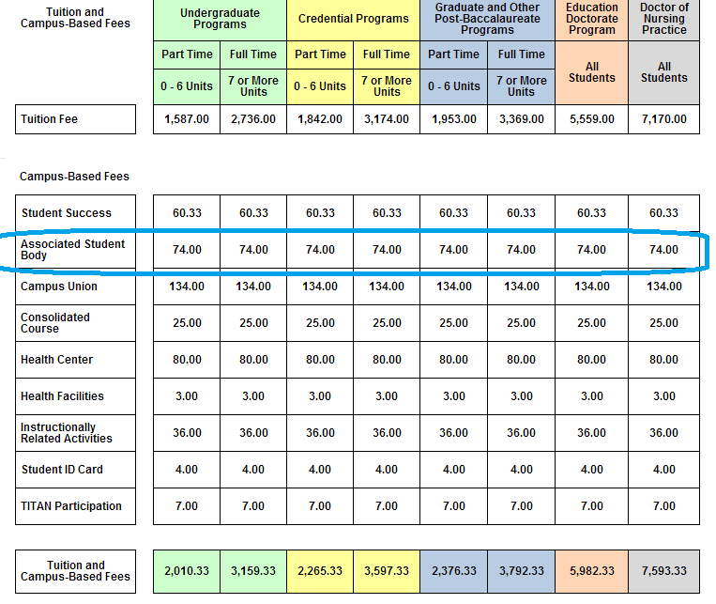

Slide 6
ROLES
Student clubs/organizations make up the body of the ICC
and the Executive Board help to facilitate meetings, provide guidance, communicate between ASI and students, and ensure a variety of Student Life & Leadership and ASI requirements are being met.

Slide 7
WHAT IS THE PURPOSE OF
COMMUNITY SERVICE ICC?
The purpose of ICC is to facilitate greater and improved communication and cooperation between the community service student clubs at California State University, Fullerton.
The ICC strives to promote and raise the awareness of the activities of its member organizations.
Community service is defined as donating one’s time and/or resources for the betterment of the public.

Slide 8
STRENGTHS & WEAKNESSES
In what area is your club doing well? And in what area is the club struggling?
For example:
Recruitment
Maintaining membership
Organization
Promoting events
Finding service projects
Funding events/programs
Support from an advisor, the university, or ASI

Slide 9
I WANT TO REQUEST FUNDS… BUT HOW?
There are many things you can request for…
-Reimbursement for supplies for a service project
-Reimbursement for meals for a service project
-Mileage to events
-Registration for large-scale events

Slide 10
HOW DO I START?
E-mail Whitney about your request to confirm it goes with ASI policies and to have the correct paperwork
E-mail Vanessa to be on the agenda
Propose at our meeting (Bring supplement to propose with)
E-mail Whitney to follow up with receiving funds

Slide 11
EXAMPLE - Reimbursement for Supplies
I want to propose a $200 reimbursement for supplies for our event: making blankets for Project Linus
***Can be before or after event (within 3 meetings)
E-mail Whitney for advice
Paperwork to do BEFORE: Funding Questionnaire and Check Request
E-mail Vanessa to be on next meeting’s agenda
Make Proposal at ICC Meeting (Bring supplement)
Paperwork to do AFTER: Bring me the ORIGINAL copy of your receipt

Slide 12
EXAMPLE - Reimbursement for Mileage
I want to propose a $500 reimbursement for gas/mileage for drivers to a homeless shelter
***MUST BE A MONTH IN ADVANCE
E-mail Whitney for advice
Paperwork to do BEFORE: Funding Questionnaire and Check Request
E-mail Vanessa to be on next meeting’s agenda
Make Proposal at ICC Meeting (Bring supplement)

Slide 13
EXAMPLE - Reimbursement for Mileage (con’t)
Papers to bring BEFORE Event (Due to Whitney 2 weeks before Departure)
From EACH Driver:
-Copy of Valid Driver’s License and Insurance
-Map with Highlighted Route
-Copy of Completed ASI Driving Course Certificate
-Authorization to Drive a Privately Own Vehicle
-Check Request form
From ALL Event Participants:
-Delegate Contract (Given to Alisia, our advisor)

Slide 14
EXAMPLE - Reimbursement for Mileage (con’t)
Papers to bring AFTER Event (Due to Whitney within a month after event)
From ALL Event Participants:
-List of all Attendees + CWIDs
-Written report of 350 words about...
topics/panels/speakers attended and what was learned from them
what will be brought back to the university by the student
how CSUF and ASI benefit from the student’s attendance at the conference

Slide 15
WHAT IS CSICC – INITIAL RESPONSES
CSICC is a funding and collaborative organization whose purpose is to support community service clubs.
Community Service Inter-Club Council allocates ASI money among service clubs for programs such as Conferences and other events.
Inter-Club Council composed of a representative from each community service club on campus. The council helps organize events as well as fund events for the individual clubs.
CSICC provides funding to enhance student activities during community service opportunities.
A club that gathers & helps fund a collected group of other clubs that's goals are to better their community.
It's a council that consists of members of various clubs, asi members, and possibly an advisor that all meet to allocate and help fund club events or those who want to go to conferences.

Slide 16
